Slide 1
FPGA Implementation of a Bitcoin Miner
Presentation by
Hassan Alabushaheen
James Richardson
Fernando Prado
Jonathan Valencia

Slide 2
Overview
What is Bitcoin?
What Does it mean to mine Bitcoin?
Our Project
Code
Performance Metrics
Performance Comparison
Conclusion
Sources

Slide 3
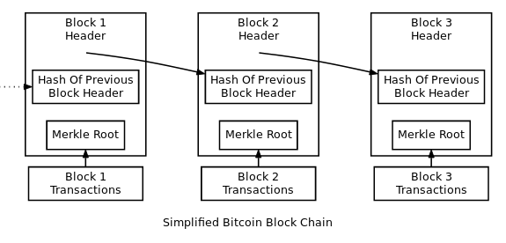
What Is Bitcoin?
Bitcoin is a decentralized digital currency.
All Bitcoin transactions are kept track of by multiple entities in a peer to peer network.
When transactions take place, they are stored in a global ledger that all of the entities in the P2P network verify.
Approximately every 10 minutes, the contents of this ledger is compacted together (along with the timestamp and a few other pieces of data) into a Bitcoin Block.
All Bitcoin blocks are linked to the previous block, forming the Bitcoin blockchain; the complete transaction history of all exchanges of Bitcoins since its existence.
Each Block has a unique 256 bit identifier that is found through a process called mining.

Slide 4
Bitcoin Miner
To mine a Bitcoin block, several different inputs are serialized, compacted together and then passed through the SHA-256 algorithm twice.
If the output of the second SHA-256 hash is below a particular number, then the block has been “Mined.”
Whoever mined this block tells everyone else in the network.
If everyone else in the network agrees that this is a valid number, and the result can be obtained with the particular inputs, then it is accepted as valid.
Once the hash has been accepted as valid, miners will begin searching for the next valid block hash.

Slide 5
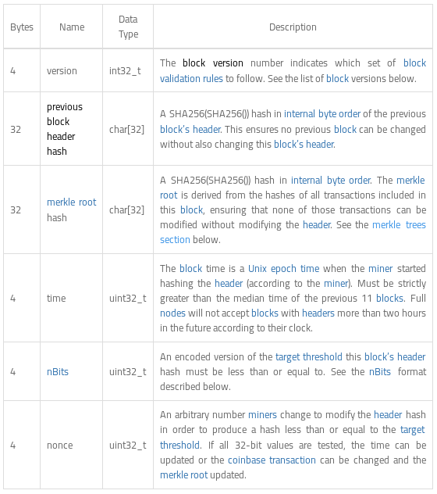
Bitcoin Miner
Most of the inputs to the SHA-256 are static values, the miner cannot change them.
If the output of the DSHA-256 is not correct, the miner will increment the “nonce” value.
The miner then tries again with the new nonce, repeating until the result of the DSHA-256 is correct or someone else in the network finds a valid hash.

Slide 6
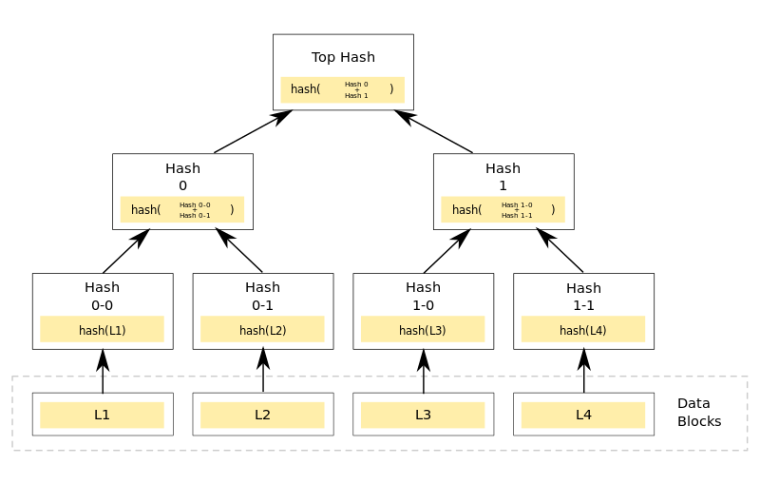
Merkle Tree / Merkle Root
A Merkle Tree is a binary tree made up of hashes.
A Merkle Root is simply a way to serialize all of the transactions in a particular block and store them as a single value.
Pairs of nodes are selected to be passed into the DSHA-256 algorithm until only a single value remains.

Slide 7
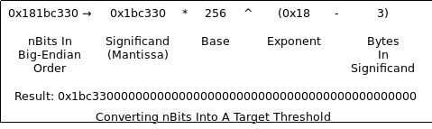
Difficulty / Target nBits
nBits is simply an encoded version of the “Difficulty” of a particular block.
The Difficulty is the value that the result of the DSHA-256 must be less than.

Slide 8
Bitcoin Mining
Why SHA-256?
It is very very hard to find a particular number using SHA-256 because the output is completely random; the output can only be determined by actually running the algorithm.
Because of this, it may take trillions of tries running the DSHA-256 to get the particular value.
Once the correct inputs are found however, it is very easy to verify that those inputs lead to the correct output. It only takes running SHA-256 once with the specified inputs.
This is called “Proof of Work” and is a fundamental concept to cryptocurrency in general.

Slide 9
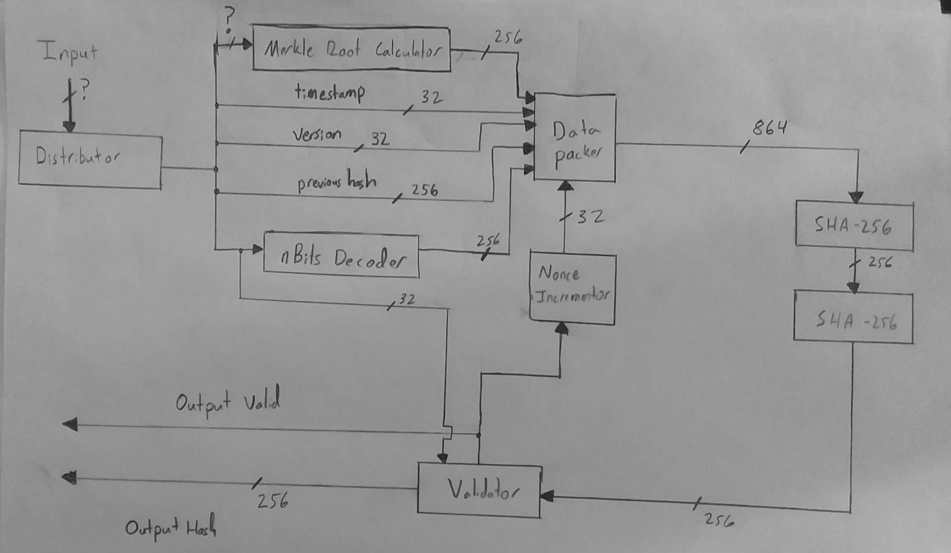
Complete Mining Design

Slide 10
What we actually got done
The only component of this that we managed to finish was SHA-256.
Though this is only one of the boxes on this design, it is a significant component.
The only other computation that would need to be implemented is the nBits Decoder.
Every other component of a complete design would be timing and routing the correct data to the correct locations.

Slide 11
SHA-256
SHA-256 is a cryptographic hash function which was designed by the NSA.
It a one way compression function that takes in an input of any length and then outputs a digest (hash value) of 256 bits.
SHA-256 is used in conjunction with many encryption algorithms such as TLS, SSL, PGP and SSH.
It is used to store passwords; the hashed value of the password is stored in a database rather than the plaintext password so that if the system is compromised only the hash is discovered (this is secure since the hash is one way and as we explained earlier finding a particular hash output from a set of inputs is very, very difficult).

Slide 12

SHA-256

Slide 13
SHA-256 Algorithm
Start with a very specific set of 8 constants, and an array of another 64 constants.
Take the input message, add a 1 to the end. Pad it with zeros and the length of the message such that the total size is 512 bit alligned
Go through the padded message in 512 bit chunks
Create an array of 64, 32 bit words, W.
Populate the first 16 entries of W with the message.
Preprocess entries of W[16] to W[63] with values calculated from the 512 bits of the message
Iterate through W one word at a time. Use this value and some operations to update the initial 8 constants.
After we have iterated through all 512 bit blocks, we do on final set of additions.
Then we concatenate the updated 8 initial constants and this is our 256 bit hash.

Slide 14
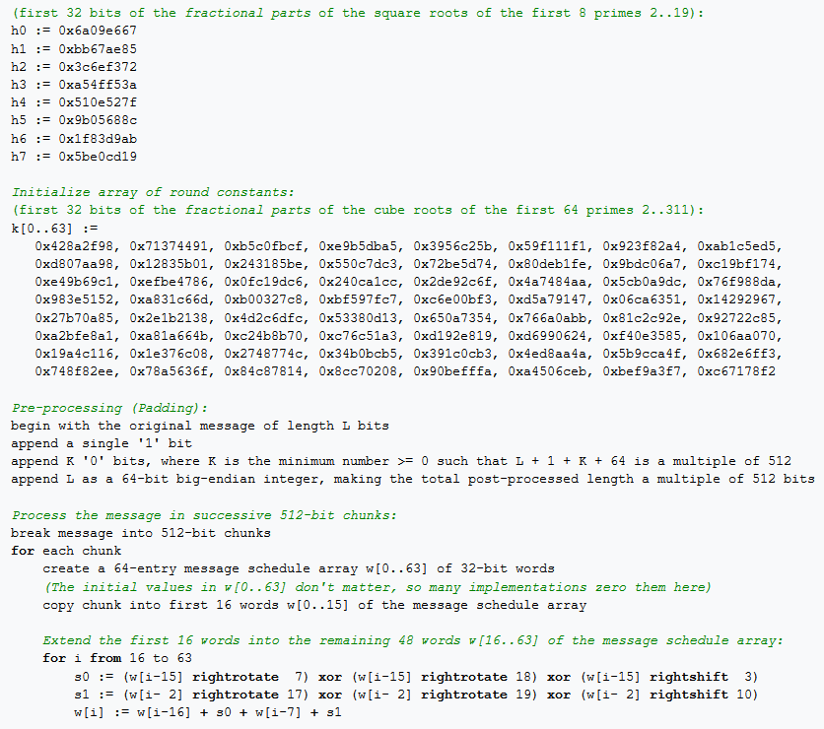
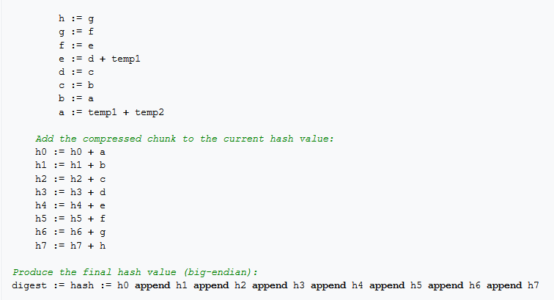
Pseudo code from Wikipedia

Slide 15
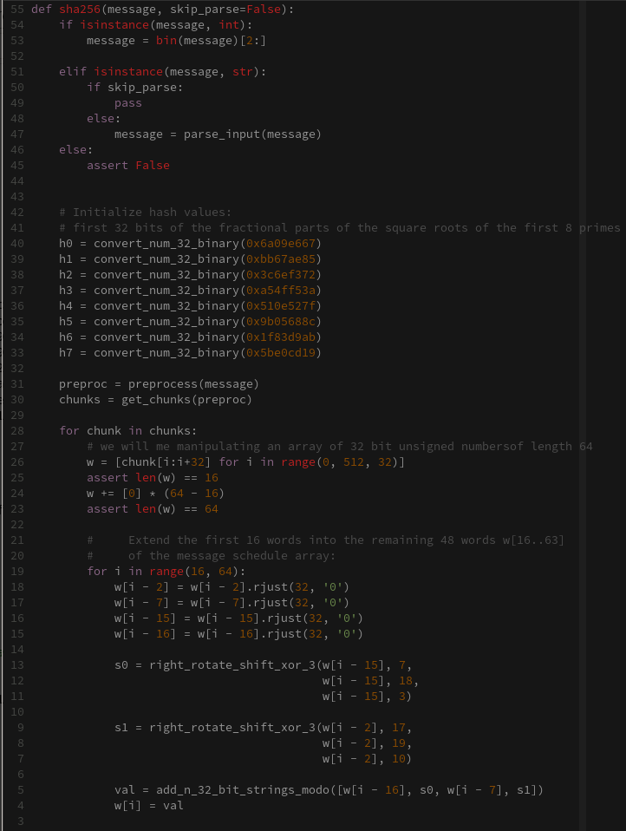
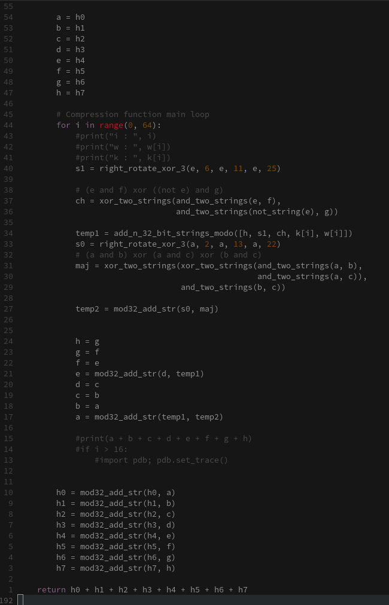
Software Simulation Code

Slide 16
Hardware Implementation
The SHA-256 was implemented with 5 separate entities
SHA256
The Main entity, tied everything together and produced the final hash
SHA_Packer
Takes the input message and produces 32 bit outputs
SHA_Preprocessor
Took in a 32 bit input from the packer, Stored it in a buffer of size 17 for later reference (needed for the algorithm) and then does necessary calculations and outputs a 32 bit preprocessed word
SHA_Manager
Takes an input from SHA_Preprocessor, a word from K and the running hash and gives this to the shifter
When the shifter is finished, takes his calculated hash and stores it
Does this a total of 64 times (from the algorithm)
SHA_Shifter
Does calculations on a given running hash, word and K value
Uses the results of those calculations to update the hash

Slide 17
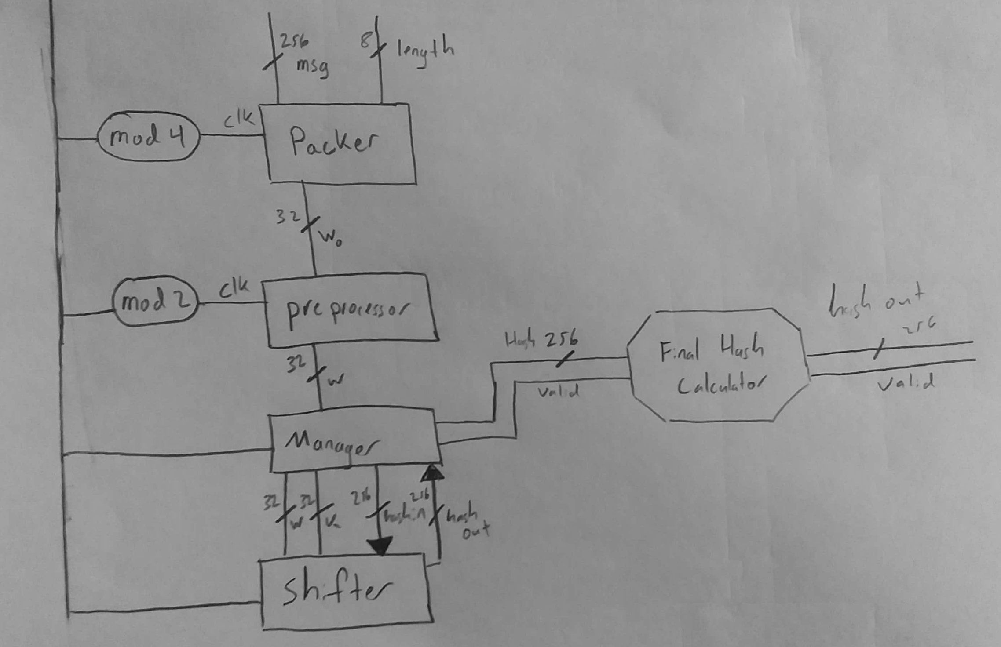
SHA-256 Hardware Implementation

Slide 18
Code
There is a lot of it…
If you want to see it you can find it here:
http://github.com/xylafur/ELET3405-BitcoinMiner

Slide 19
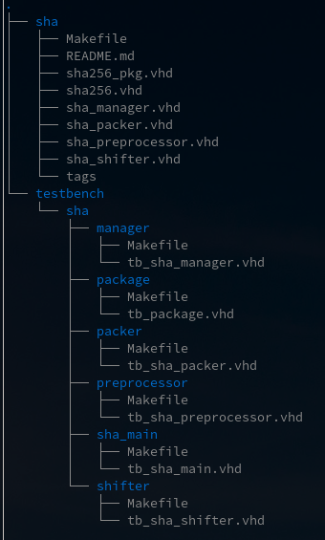

Code
Most of the code ended up being test benches instead of actual design. :(

Slide 20
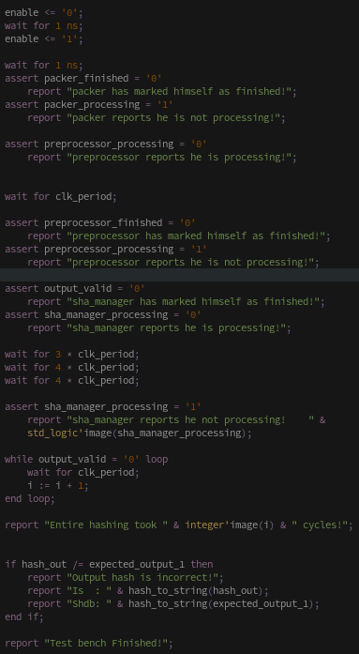
Test Bench
Most of the design was done using test benches for verifying timing and results.
The program ‘ghdl’ was used to compile all of the code locally and run simulations.
Using the software was actually pretty simple, and really aided in design… Until it didn’t
Word of advice: Use the Compiler / Synthesizer for the platform you are developing for, no matter how convenient another platform is.

Slide 21
Test Bench

Slide 23
FPGA Hashing Performance
Calculating one hash value using our implementation took 249 clock cycles.
If we would have been able to successfully synthesize our completed code with Quartus, we would have been able to determine routing; we could have determined the actual propagation delay and the maximum rate at which we could drive the clock.
If we assume a lower bound propagation delay of 2ns, then we could achieve 4016 hashes per second.
If we were able to run this implementation with the 50MHz clock on the board, we could achieve 200803 Hashes per second. This would mean that our maximum propagation delay would have to be less than 2e-08 seconds.
https://www.alldatasheet.com/datasheet-pdf/pdf/530608/ALTERA/EP4CGX150.html

Slide 24
Bitcoin Software Implementation
In the official Bitcoin source code located on github, there is an implementation of SHA256 written completely in x86 assembly.
This assembly code contains 902 instructions.
Looking specifically at the Intel Skylake 6th Generation Pentium Processor :
The SKL-Y-1 model will have 2 cores. There isn't information given on clock speeds but Intel's current Core M processors have a base clock speed of up to 1.2 GHz, with "turbo" up to 2.9 GHz. Let's suppose this new Skylake device could run at 3 GHz sustained.
Overall Hash rate is given by dividing the clock speed by the number of clocks per hash muitplied by the number of cores :
3x^10 clock/sec / (64 clocks/hash * 2 cores) = 93.75Mhash/sec

Slide 25
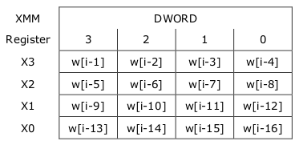

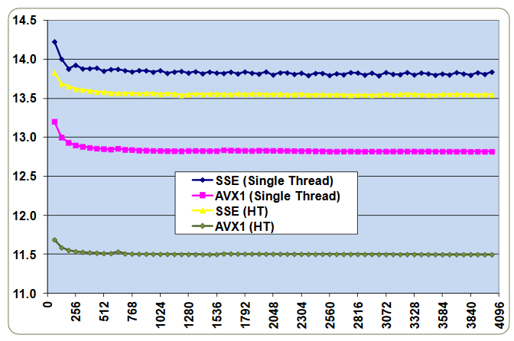
Intel Processor Hashing Performance
Fast SHA-256 Implementations on Intel®Architecture Processors
Jim Guilford, Kirk Yap, Vinodh Gopal
https://www.intel.com/content/dam/www/public/us/en/documents/white-papers/sha-256-implementations-paper.pdf
In this paper, parallelism was implemented during preprocessing. Four DWORDS are able to be stored and used in computations all at the same time because of the way intel’s XMM register is set up. Four “s0” values are able to be calculated at a time, while 2 “s1” values are able to be calculated. Scheduling is done two blocks at a time, with four (DWORD) lanes used per block.
In the examples that they used in the data sheet, the SSE version was ran on a Intel Xeon Processor (2.93 GHz & 12 threads) and the AVX1 was ran on an Intel core i7-2600 processor (3.4GHz & 8 threads). They measured the performance of the functions on data buffers of different sizes. The following graph shows performance in cycles/bytes as a function of buffer size.

Slide 26

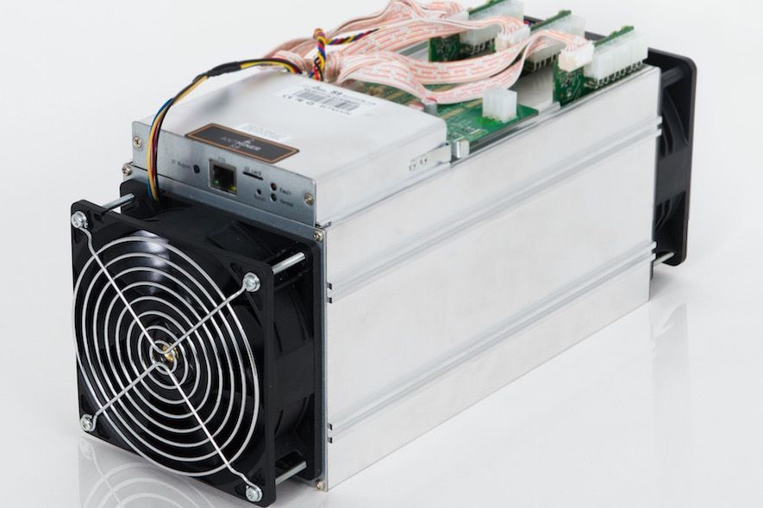
ASIC Hashing Implementation
Currently the “Bitmain Antminer S9” is the leading ASIC for mining bitcoin.
Its able to compute 14 Tera Hashes per Second
It has a whopping price tag of $3000
Power consumption: 1372W
Required an Antminer Power Supply APW3++
Cost ($200) maximum output power is 1600W.
The special edition SE s9 which sold for $350

Slide 27
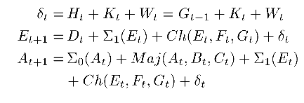

Optimizing Hardware Hashing Performance
Cost-Efficient SHA Hardware Accelerators
Ricardo Chaves, Georgi Kuzmanov, Leonel Sousa, ,and Stamatis Vassiliadis
The Critical path of the SHA256 algorithm is the additions required to compute Σ0 and Σ1. Additions are time consuming operations compared to shifts and rotates.
These researchers were able to take advantage of the way in which the running hash is updated for each of the 64 cycles of the SHA-256 algorithm.
A and E are the only values that need to actually be computed: B, C and D are computed from previous values of A, and F, G and H are computed from previous values of E. A and E are stored in a buffer, and used to update the final hash values.
The value 𝛔1 is able to be computed separately on the previous clock cycles, halving the number of required additions

Slide 28
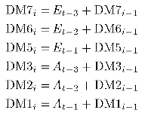
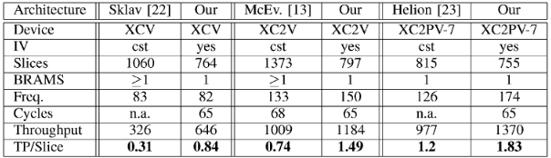

Optimizing Hardware Hashing Performance
Cost-Efficient SHA Hardware Accelerators
Ricardo Chaves, Georgi Kuzmanov, Leonel Sousa, ,and Stamatis Vassiliadis
All of the digest messages can be computed from previous values of A and E along with previous digest messages.
The researchers were able to take advantage of this to only need two addition units.
Carry Save adders were also able to be utilized for this, rather than full adders, reducing the time required for the additions.
With these optimizations, the Researchers were able to produce a throughput of 1.4 Gbit/s
The researchers reported an improvement 150 times greater than that of a complete software implementation.

Slide 29
Conclusion
The only feasible way to produce a hash rate high enough to make a profit mining Bitcoin would be to use specialized hardware. Software implementations have long been obsolete, but even FPGAs would not be practical.
Though an FPGA may be ideal for prototyping, it would not be able to make you any money mining money, since its hash rate is so much too low, and its power consumption is much too high.
The clock can be driven much higher for an ASIC than an FPGA, since the actual combination logic is fabricated rather than LUTs. Any hardware optimizations used for an FPGA could also be applied to an ASIC, resulting in even greater performance.
Additionally, the price of an entire fabrication of Specialized mining ASICs would be much lower than that of the price of the same number of FPGAs.

Slide 30
Sources
https://bitcoincore.org/bitcoin.pdf
https://bitcoin.org/en/developer-documentation
https://bitcoin.org/en/developer-reference#term-raw-format
https://en.wikipedia.org/wiki/Merkle_tree
https://en.bitcoin.it/wiki/Difficulty
https://bitcoin.org/en/glossary/serialized-transaction
https://www.intel.com/content/dam/www/programmable/us/en/pdfs/literature/an/an433.pdf
https://en.wikipedia.org/wiki/Sha-256
https://www.buybitcoinworldwide.com/mining/hardware/antminer-s9/
https://electronics.stackexchange.com/questions/123760/how-can-a-cpu-deliver-more-than-one-instruction-per-cycle
https://news.bitcoin.com/bitmain-launches-low-cost-special-edition-antminer-s9/

